Slide 1


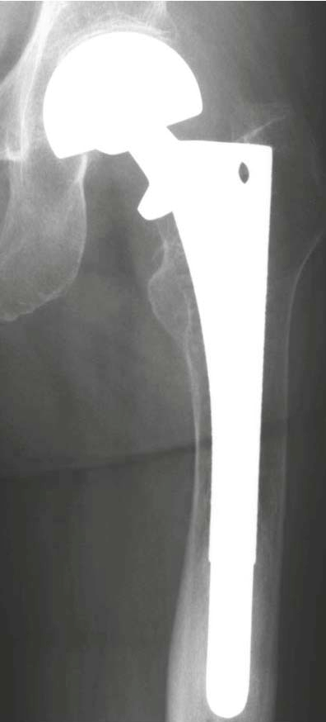
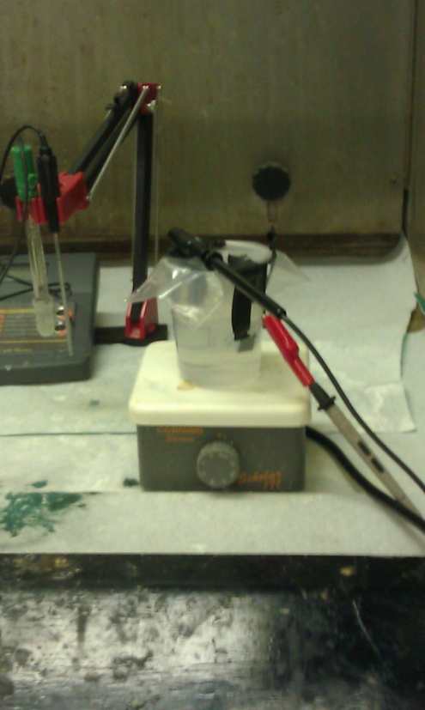

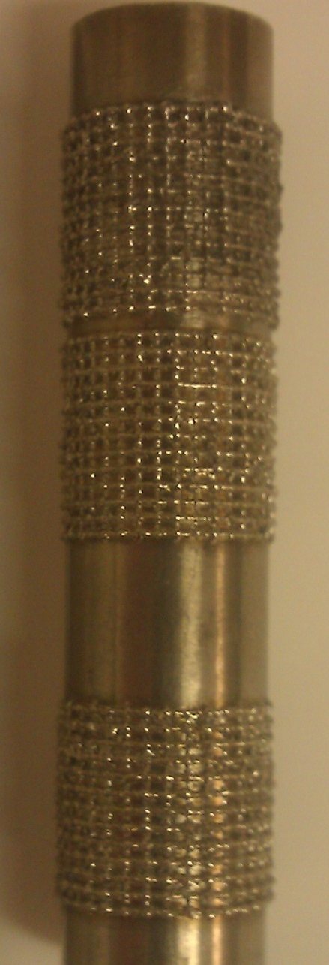
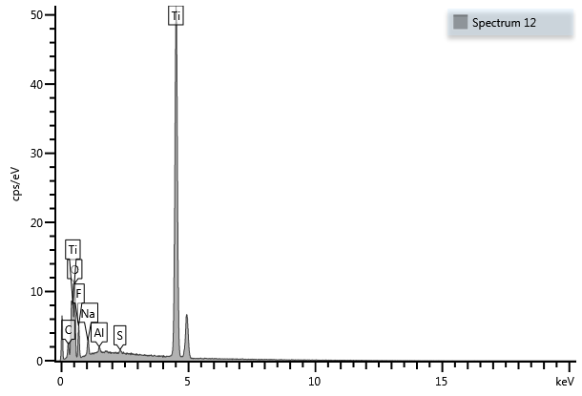
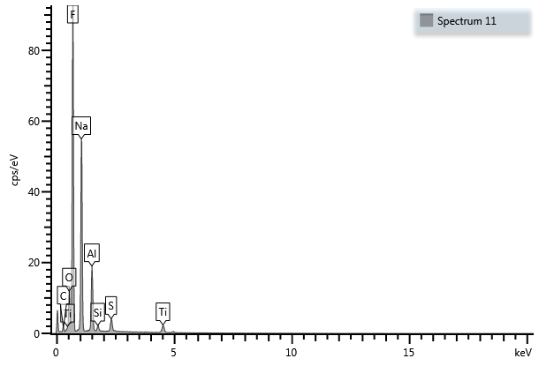
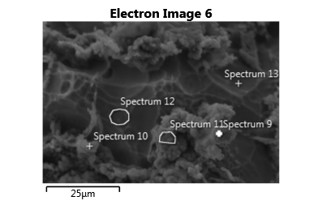
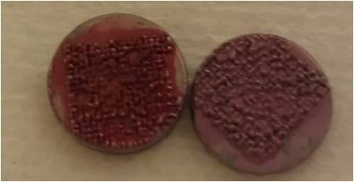
Processing and Characterization of Hierarchical TiO₂ Coatings on Ti Implants
Research Undergraduate: Christine McLinn
Faculty Advisor: Dr. Grant Crawford
Introduction
Discussion
Broader Impact
Objective: Modify the surface of titanium to include a hierarchical organization made up of a microstructure created by laser deposition or cold spray as well as a nanostructure of TiO₂ nanotubes. Then determine whether this combination will improve bioactivity of implants compared to current titanium medical implants.
Mean roughness of cold spray is around 7.4 µm with a peak to valley distance of ~41µm. Ideally want a roughness of 200-250µm for improved bone integration.
Cold spray thickness varies greatly across the surface of the samples.
Nanotubes on cold spray formed in valleys where a smoother looking surface was present
Odd precipitate forms on cold spray sample during anodic oxidation. This difference could be due to the presence of cold spray particles themselves or contamination of the Ti powder.
If successful this may improve integration of orthopedic implants into the bone for many knee and hip replacement patients.
Could potentially reduce bone resorption which can cause loosening of implants and sometimes necessitates revision surgery.
Possibly increase lifetime of orthopedic implants.
Results
Procedure
Sample 1 |  |  | Sample 2
Trial | Ra (µm) | Rz (µm) | Trial | Ra (µm) | Rz (µm)
1 | 7.187 | 42 | 1 | 8.525 | 45.4
2 | 6.998 | 38.2 | 2 | 6.809 | 40.9
3 | 7.448 | 41.7 | 3 | 7.54 | 40.1
4 | 8.007 | 46 | 4 | 6.992 | 37.2
5 | 7.464 | 41.1 | 5 | 7.292 | 40.4
Average | 7.421 | 41.800 | Average | 7.432 | 40.800
Standard Deviation | 0.381 | 2.790 | Standard Deviation | 0.672 | 2.949
Types of Surface Modifications:
Nanostructure
Nanotubes- created using anodic oxidation in an electrochemical cell
Microstructure
Cold Spray – 40 micron titanium particles shot onto the sample surface using helium
Laser Deposition- lay down grid pattern
Cell culture
Place mouse fibroblast cells (3T3s) on samples and feed cells for two weeks
Staining Procedures
Alizarin Red (Calcium)
Von Kossa (Calcium)
Alkaline Phosphatase (ALP activity)
This table contains profilometry data for cold spray surfaces. Where R_{a} is the arithmetic mean roughness and R_{z} is the peak to valley height both measured in µm.
Conclusions
It is possible to create a hierarchical structure consisting of cold spray particles and TiO₂ nanotubes. However, at this point the nanotubes are not uniformly distributed across the surface of the sample.
Further testing must be done in order to draw conclusions whether these structures cause an improved biological response.
Cold spray cross sections after being etched with Kroll’s reagent.
Future Work
20 µm
2 µm
200 nm
Further cell response testing
Test alloys like Ti-6Al-4V
Laser deposition for microstructure
Adjust pH used to grow nanotubes on cold spray surface
Adjust cold spray particle size to create greater surface roughness
SEM images taken of a sample with both cold spray and nanotubes. Smoother flat regions like the middle picture were where nanotubes were located.
Element | Wt% | Wt% Sigma
O | 21.00 | 0.35
F | 9.56 | 0.22
Na | 1.42 | 0.06
Al | 0.33 | 0.03
S | 0.22 | 0.03
Ti | 67.48 | 0.35
Total: | 100.00
Unexpected precipitate layer formed on the cold spray with nanotubes samples. This layer contained a lot of aluminum, sulfur, silicon compared to the nanotube valley.
Element | Wt% | Wt% Sigma
O | 5.92 | 0.12
F | 49.55 | 0.18
Na | 29.33 | 0.15
Al | 9.23 | 0.10
Si | 0.79 | 0.04
S | 2.02 | 0.05
Ti | 3.15 | 0.09
Total: | 100.00
SEM EDS was used to identify elements present on the cold spray with nanotubes surface.
Examples of Alizarin red and von Kossa stains.
Acknowledgments
Thanks to the National Science Foundation REU Site Award #1157074, Dr. Grant Crawford, Dr. Michael West, and Dr Alfred Boysen for their guidance.
Notes:
Bone resorption image:
http://www.springerimages.com/Images/MedicineAndPublicHealth/1-10.1007_s00776-008-1317-4-9

